Slide 1
FLIP GRID
Aditya pawar
FYIT_107
MAKE LEARNING FUN.

Slide 2
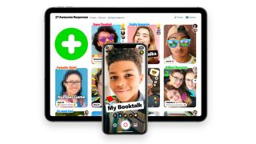
What is Flipgrid and How Does it Work for Teachers and Students?
By Luke Edwards published April 19, 2021
Flipgrid is the video discussion tool from Microsoft that opens up the classroom
Flipgrid is a video discussion tool quite like no other as it's designed with the might of Microsoft to work specifically for teachers and students in a digital classroom.
The idea behind this education tool is to use video to create an open platform of discussion and learning that doesn't require a physical classroom to get everyone involved. That makes Flipgrid an ideal remote learning tool as well as a powerful homework based application for students to use with each other.
Flipgrid is designed to allow students to speak to the group but
without the same fear that might constrict responses in a real-world
situation. Students can re-record responses, removing the pressure of
answering in class, on the spot. Of course, it's also a great tool for
use when learning remotely.
(Image credit: Flipgrid)

Slide 3
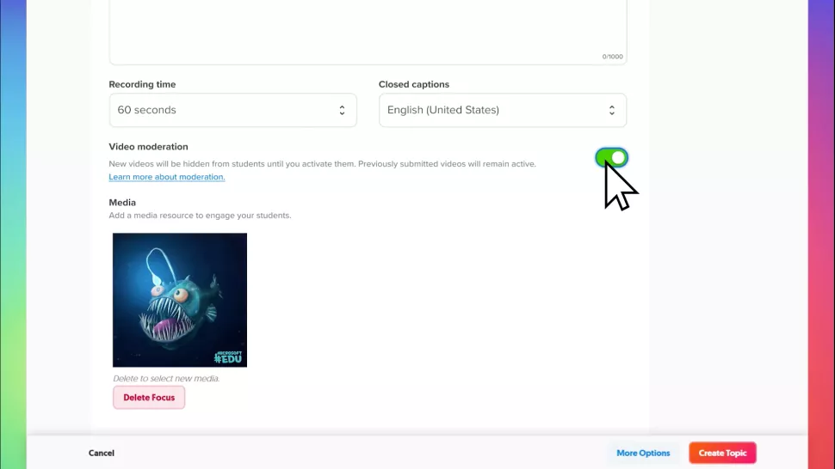
So, in more detail, what is Flipgrid and how does it work in education?
What is Flipgrid?
At its most basic, Flipgrid is a video tool that allows teachers to post "Topics" that are essentially videos with some
accompanying text. This is then shared with students, who can be prompted to respond.
The response can be made using the software’s camera to create videos that are then posted to the original Topic. These videos can be recorded as many times as needed before uploading, and can have the addition of emoji, text, stickers, drawings, or
custom stickers.
The service works online so it can be accessed
via web browser from nearly any device, or
through the app, making it good for laptops,
tablets, smartphones, Chromebooks,
and desktop computers. The only
requirement
on any of those devices is a camera and has
enough processing power to back
that up.
Flipgrid is free to use and can be accessed
using
a Microsoft or Google account.

Slide 4
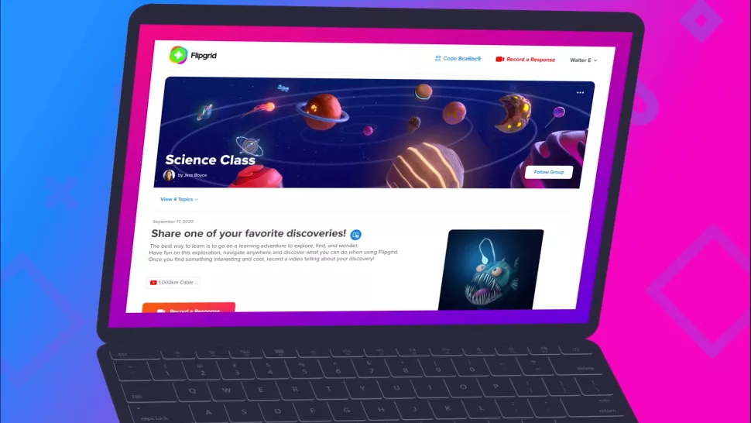
What's Good About Flipgrid?
One of the best things about Flipgrid is the ability to interact using video, such as face-to-face in the real world, but without the pressure of a live classroom. Since students are given the space and time to respond when they're ready, it makes educational engagement possible for even more anxious students who might ordinarily feel left out in class.
The ability to add rich media encourages students to be creative and, potentially more importantly, expressive. By adding emoji, text, and stickers, students can engage with class content as they might interact with friends using social media platforms.
This aspect can help students feel less apprehensive
and more empowered to express themselves openly,
engaging more deeply with the task. Ultimately, that
should result in deeper learning and better content
recall.
On a software level, Flipgrid is great for integration.
Since it works with Google Classroom, Microsoft Teams,
and Remind, it's easy for a teacher to integrate into
the current virtual classroom setup.

Slide 5
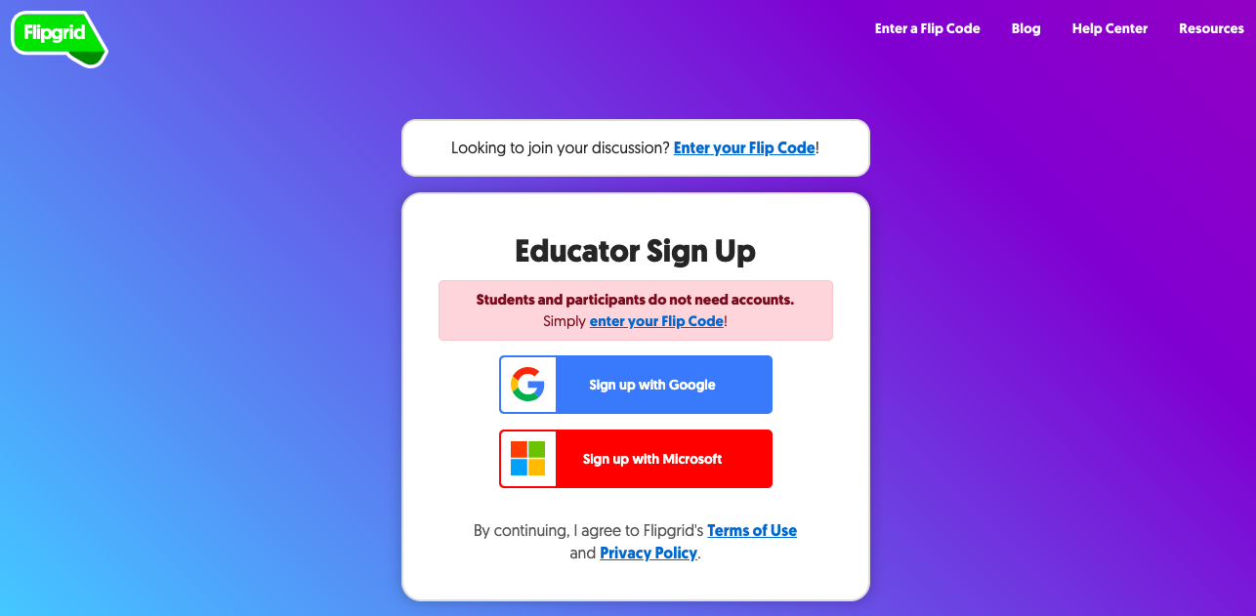
How Does Flipgrid Work?
The process is pretty straightforward to get set up and start using Flipgrid. A teacher can simply go to Flipgrid to get signed up by using a Microsoft or Google account.
Then it's time to create your first Topic. Select "Add a Topic." Give it a title and you can post a video, such as a YouTube clip, right there. Optionally, add a "Prompt," which is text to describe what's going on and what you want in response.
Then add the emails of those students you want involved by adding a student username if they're not using email. This can be setup by adding a student and sending them the required link and code. Add an optional password, if needed.
Select "Create Topic" and then you are given a link to share with the option to copy as well as to quickly pick what platform you want to auto share to, including
Google Classroom, Microsoft Teams, and so on. Students
can then login and use the myjoincode to get into the
Topic directly to watch the video and post their response.
The video response then appears on the page below the
original Topic Prompt. These can be commented on by
other students, using text, but permissions can be set and
controlled by the teacher as they see fit.
Flipgrid currently offers more than 25,000 lessons and
activities, and more than 35,000 Topics, helping you to
create new Topics or use existing
ones quickly and easily.

Slide 6
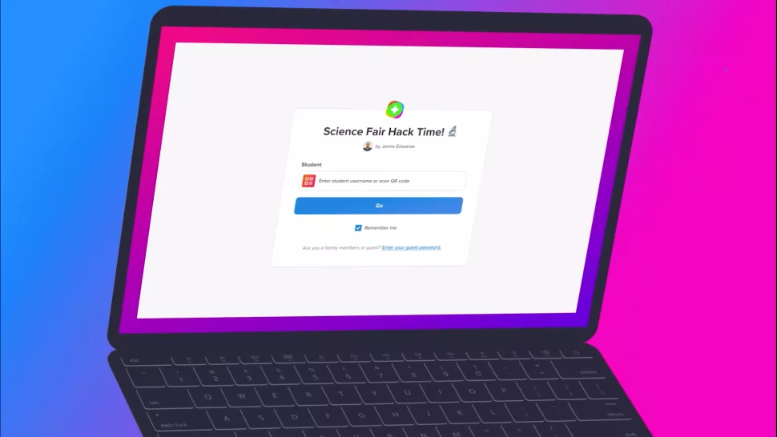
Flipgrid Features
While Flipgrid keeps things minimal, making it easy to use, there are still plenty of useful settings that you can tweak. Get your offering just right and it can be tailored to get the best engagement possible with the class.
Here's some lingo guidance and tips to help you understand what's available to use.
Flipgrid Grids
A "Grid" is the term used by the Flipgrid
community to describe a group of learners.
In the case of a teacher, a Grid could be
the class or a small group.
This is where you can create a custom Flip
Code that is then used to share with
anyone you want to enter into that group.

Slide 7
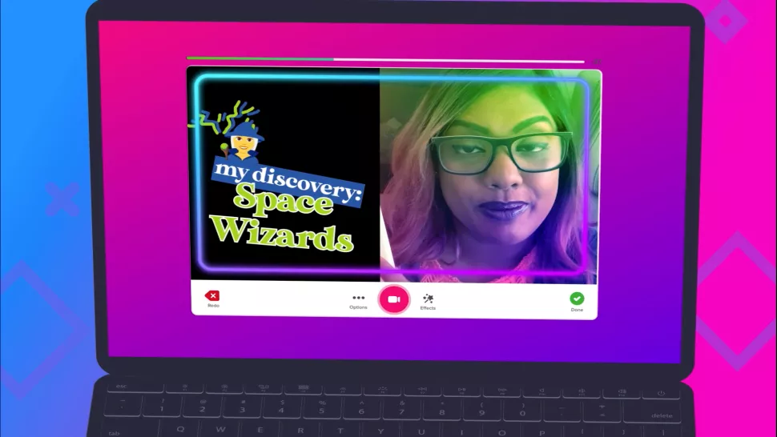
Flipgrid Topic Guests
Want to integrate more than your own Topics? It is possible to use Topic Guests, aka, Guest Mode, to allow others to input.
This is ideal if you want a specialist speaker, for example. Equally, this is a powerful option if you want to include guardians in the process, since this is online and that becomes a real possibility.
Flipgrid Shorts
This video tool allows teachers and students to create their videos for a custom finish rather than simply uploading a YouTube clip.
Users can upload and edit video, add more clips,
cut, and segment as well as enhance with
emojis, stickers, and text. Add arrows to a graph
image as you talk over that section of the video,
for example, as a great way to get in-depth
information across.
Shorts is, essentially, a really simple-to-use video
editing tool that can produce a powerful result,
depending on how creative you want to be.

Slide 8
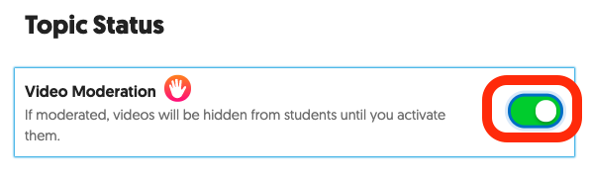
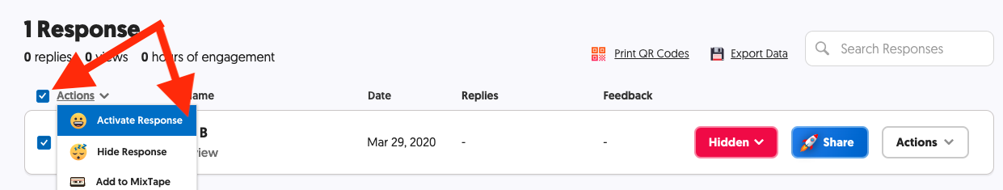
Flipgrid Video Moderation
One way to stay in control of the content submitted by students is to set the Video Moderation mode to on when you post a new Topic. In doing so, any video uploaded will not be posted until you have checked and approved it.
This is a useful tool when starting out, but once trust has built and you're confident, it's also good to have this setting off to save time on moderating. When it's off, students can also enjoy more freedom of expression in real-time.
You can always select individual videos to hide or
delete at a later time.
What is Google Classroom?
Best webcams for teachers and students in education
Best Chromebooks for school

Slide 9

Thank you :)

